Slide 1
GENDER and Age Prediction using CNN
SUBMITTED BY :
S.GANESH KUMAR,
III year – CSE,
Reg.no. 912321104006
SACS MAVMM ENGINEERING COLLEGE,
MADURAI.

Slide 2
OUTLINE
Problem Statement
Proposed System/Solution
System Development Approach
Algorithm/Deployment
Result
Conclusion

Slide 3
Problem statement
In this project, I developed separate convolutional neural network (CNN) models to predict the gender and age of individuals from facial images. My goal was to accurately classify gender (male or female) and estimate age based on facial features extracted from images.

Slide 4
Proposed Solution
Convolutional Neural Network
Convolutional Neural Network (CNN) is the extended version of artificial neural networks (ANN) which is predominantly used to extract the feature from the grid-like matrix dataset. For example visual datasets like images or videos where data patterns play an extensive role.

Slide 5
PROPOSED SOLUTION (CONTD...)
CNN Architecture
Convolutional Neural Network consists of multiple layers like the input layer, Convolutional layer, Pooling layer, and fully connected layers.
A complete Convolution Neural Networks architecture is also known as covnets. A covnets is a sequence of layers, and every layer transforms one volume to another through a differentiable function.

Slide 6
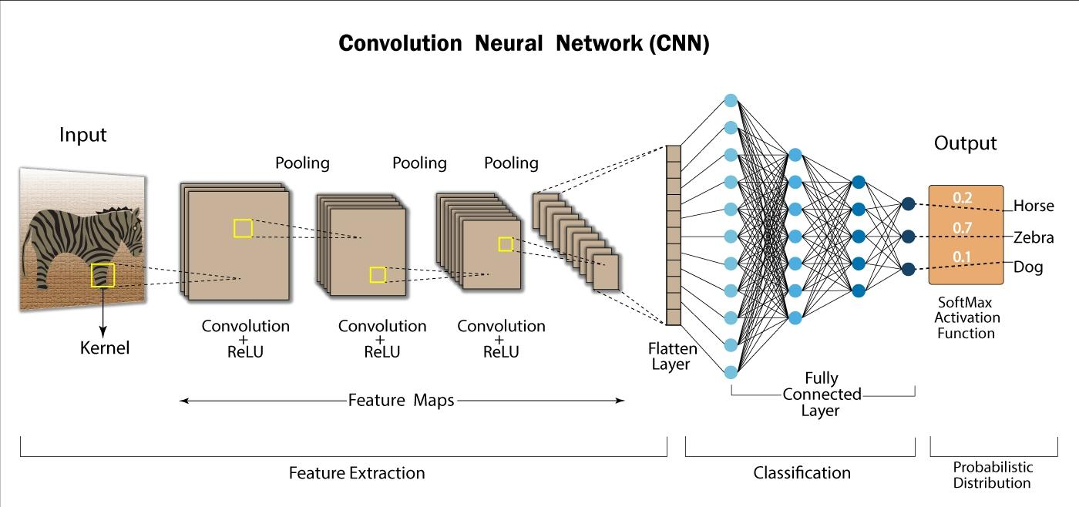
PROPOSED SOLUTION (CONTD…)

Slide 7
System approach
System Requirements:
1.Hardware requirements:
CPU: A multi-core processor (e.g., Intel Core i5 or higher) for training and inference.
GPU: NVIDIA GPU with CUDA support for faster training of deep learning models.
RAM: At least 8 GB of RAM for handling large datasets and model training.
Internet Connection : A stable internet connection is necessary for downloading.

Slide 8
System approach (conTD…)
2.Software requirements:
Python: Python 3.x with essential libraries.
Development Environment: Use an integrated development environment (IDE) like Google co-lab.
Data Visualization Tools: Use tools like Matplotlib or Seaborn for visualizing images, model performance metrics, and training validation curves. For frame work using Tensor flow.

Slide 9
Algorithm & deployment
Data collection:
Download the UTKFace dataset. The UTKFace dataset contains face images with labels for age, gender, and ethnicity.
Data Preprocessing:
Resize all images to a consistent size, convert them to a suitable format.
Model Architecture:
Design a CNN architecture suitable for the task. Then start with a common architecture for specific requirements.

Slide 10
Algorithm & deployment (conTD…)
Training:
Split the dataset into training, validation, and test sets.
Train the CNN model on the training set using appropriate loss functions and optimization algorithms.
For age prediction, consider using mean squared error loss or ordinal regression loss.
For gender prediction, binary cross-entropy loss is suitable.

Slide 11
Algorithm & deployment (conTD…)
Evaluation:
Evaluate the trained model on the validation set to assess its performance. Fine-tune the model and hyper parameters based on the validation results to improve its performance.
Testing:
Once satisfied with the model’s performance, evaluate it on the test set to obtain unbiased estimates of its accuracy.

Slide 12
Algorithm & deployment (conTD…)
Deployment:
Deploy the trained model to make predictions on new face images.
The UTKFace dataset provides a diverse range of face images spanning different ages, genders, and ethnicities.
Making it suitable for training models for age and gender prediction tasks.
However, it’s essential to preprocess the dataset carefully and design a robust CNN architecture to achieve accurate predictions.

Slide 13
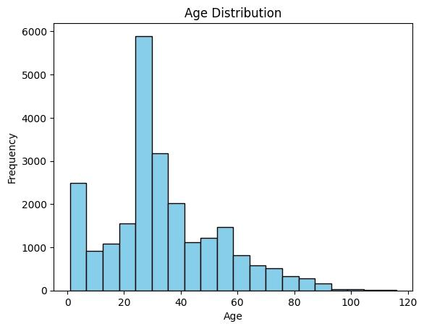
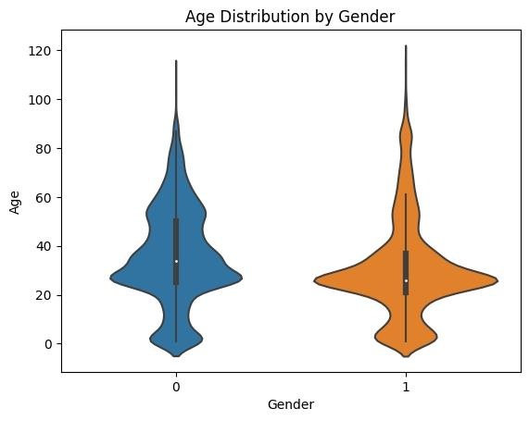
Result
Fig. Age distribution
Fig. Age distribution by gender

Slide 14
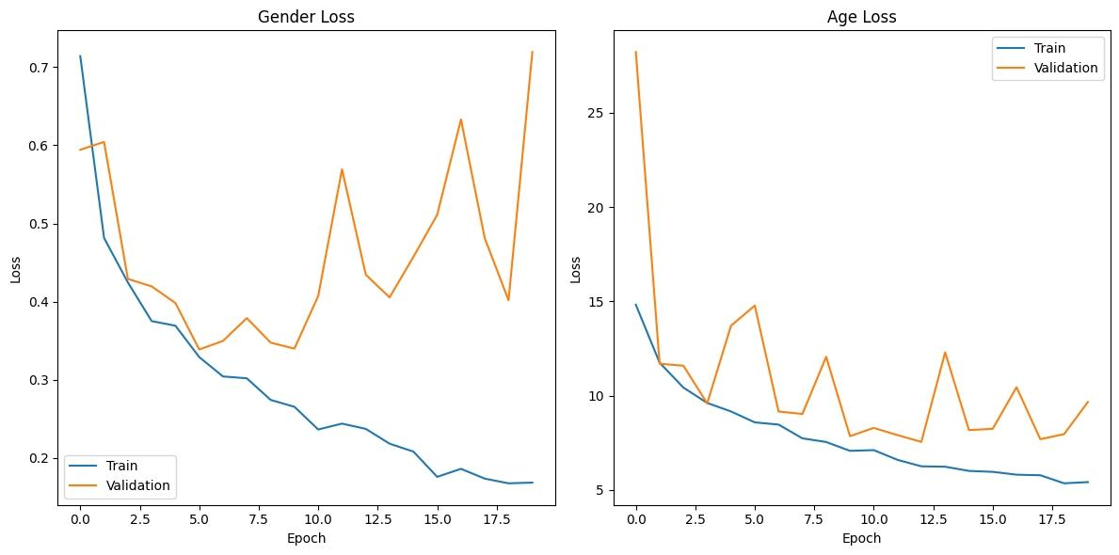
Result (conTD…)
Fig. Gender loss
Fig. Age loss

Slide 15
Conclusion
My project demonstrated the feasibility of predicting gender and estimating age from facial images using CNN model. While the models showed promising results, further optimization and fine-tuning could potentially improve their accuracy and generalization to unseen data.

Slide 16
References
https://www.kaggle.com/datasets/jangedoo/utkface-new/download?datasetVersionNumber=1
www.geeksforgeeks.com
www.google/co-lab.com
www.Tensorflow.com
www.Github.com

Slide 17
THANK YOU

